Slide 1
Jonah & Discovery Bible Study

Slide 2
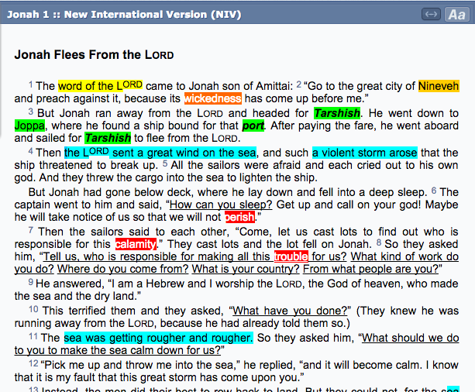
Biblegateway & Scrible

Slide 3
Google Doc (Text from Biblegateway)

Slide 4
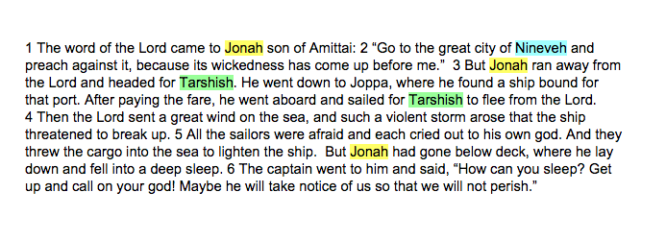
Google Doc & Pearl Word Search

Slide 5
Repeated Themes
God’s Initiation
Human Characters
Geographical Locations
Wickedness/ Sin
Emotions
Questions
Prayer
Threatening Situations
Death
Compassion/Love/Grace

Slide 6
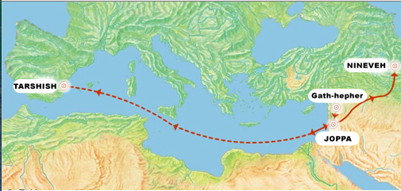
4 Locations Mentioned in Jonah
MOSUL
1
2
4
T E M P L E
3
JAFFA

Slide 7
Nineveh & Tarshish
Nineveh was rediscovered by Austen Henry in the 1800s
The exact location of Tarshish is still unclear

Slide 8
Jonah in the OT

Slide 9
2 Kings 14:25 (The only other OT reference to Jonah)
14:25 [King Jeroboam II] was the one who restored the boundaries of Israel from Lebo Hamath to the Dead Sea, in accordance with the word of the Lord, the God of Israel, spoken through his servant Jonah son of Amittai, the prophet from Gath Hepher.

Slide 10
Neo-Assyrian Period
883-612 BC

Slide 11
Jeroboam II: 789–748
Ashurnasirpal II 883 - 859 Nineveh was one of the great cities of the East
Shalmaneser III 858 - 824
Shamshi-Adad V 823 - 811
Adad-nirari III 810 - 783
Shalmaneser IV 783 - 773
Ashur-dan III 772 - 755
Ashur-Nirari V 754 - 745
Tiglath-Pileser III 744 - 727
Shalmaneser V 726 - 722
Sargon II 721 - 705
Sennacherib 704 - 681 Moved capital back to Nineveh
Period of King Jeroboam II (King in Israel)
http://studentreader.com/neo-assyrian-timeline/#Ashurnasirpal-II

Slide 12
Jeroboam II: 789–748
Ashurnasirpal II 883 - 859 Nineveh was one of the great cities of the East
Shalmaneser III 858 - 824
Shamshi-Adad V 823 - 811
Adad-nirari III 810 - 783
Shalmaneser IV 783 - 773
Ashur-dan III 772 - 755
Ashur-Nirari V 754 - 745
Tiglath-Pileser III 744 - 727
Shalmaneser V 726 - 722
Sargon II 721 - 705
Sennacherib 704 - 681 Moved capital back to Nineveh
Period of King Jeroboam II (King in Israel)
Jonah lived either before or during the reign of King Jeroboam II
http://studentreader.com/neo-assyrian-timeline/#Ashurnasirpal-II

Slide 13
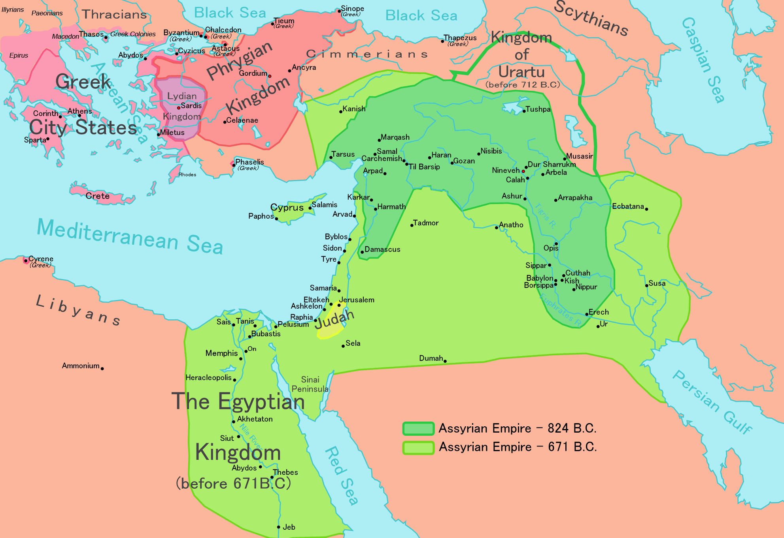
The Assyrian Empire was rising during Jonah’s day.

Slide 14
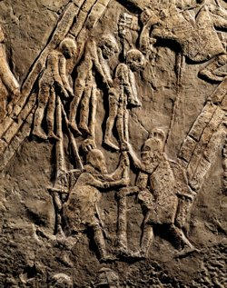
Sennacherib Impaled Jewish Prisoners
This took place after Jonah’s lifetime.

Slide 15
Assyrians Brutalized People
They cut off hands, noses, ears, and heads.
They sometimes skinned people alive and stretched out their skins on city walls.
Perhaps this helps us understand Jonah more and causes us to be in greater awe of God’s compassion and grace toward the Ninevites.

Slide 16
Jonah in the NT

Slide 17
Matthew 12:38-41
38 Then some of the Pharisees and teachers of the law said to him, “Teacher, we want to see a sign from you.” 39 He answered, “A wicked and adulterous generation asks for a sign! But none will be given it except the sign of the prophet Jonah. 40 For as Jonah was three days and three nights in the belly of a huge fish, so the Son of Man will be three days and three nights in the heart of the earth. 41 The men of Nineveh will stand up at the judgment with this generation and condemn it; for they repented at the preaching of Jonah, and now something greater than Jonah is here.

Slide 18
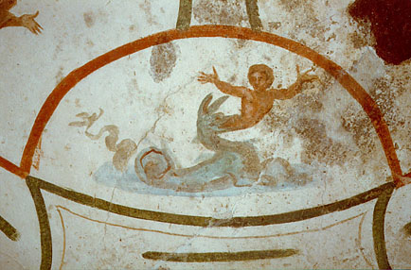
Jonah and Early Christians
“The image of Jonah and the fish was used by . . . early Christian groups as a symbol of Christ and his resurrection, based on a reference by Jesus to Jonah in a passage in the gospel of Matthew (12:39-40). The Jonah ‘sign’ became the quintessential expression of Christian resurrection faith in later centuries with over a hundred examples of Jonah images in the Christian catacombs at Rome.” Link
Image Link Jonah’s fish from the catacombs.

Slide 19
Jonah Today

Slide 20
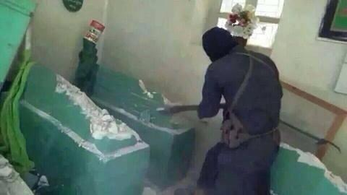
Jonah Today: His Tomb in Mosul Iraq
Full news story July, 2014
http://d3dyqb2m69ozbp.cloudfront.net/wp-content/uploads/2014/07/Prophet-Younus-Grave-Destroyed.jpg

Slide 21
Jonah Today
Jonah’s Tomb
CNN News Video: July 25, 2014
Iraqi Christians Flee Mosul
ZAK News

Slide 22
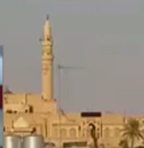
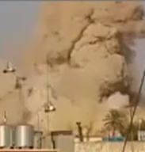
Destruction of Jonah’s Tomb

Slide 23
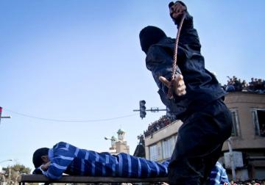
Protesters Flogged
In an interview with IraqiNews.com [one person said] that “after the crime of exploding the shrine of Prophet Yunus ISIL’s popularity has fallen dramatically and a big demonstration formed after Friday prayers criticizing this action, but the gangs ISIL arrested its leadership and flogged everyone of them a hundred lashes.”
Weblink to image and text

Slide 24
Explanation: What did God want to teach Jonah?
What was the author and audience struggling with?
What was it like to live in their world?
Why did Jonah not want to go to Nineveh?
Why was Jonah mad that God showed compassion to the Ninevites?

Slide 25
Application: What does God want to teach Iraqi Christians?
How does God want (Iraqi) Christians to treat members of ISIS?

Slide 26
Application: What does God want to teach me?
Who are my enemies?
How does God want me to treat them?

Slide 27
More on Jonah
Learn the Discovery Bible Study Method at:
Do a Google search for
The EdAble Bible Project
https://sites.google.com/site/edablebible/

